Slide 1


New Vegan Restaurant in Madrid
Location recommendation report.

Slide 2

Problem:
Vegan restaurants are on the rise in Europe. It's still a good opportunity, but it takes timely market research.
Today more than ever, the profession of chef is especially valued.
From an economic point of view, in the most successful cases a return of 25% has been achieved.
Is vital to define our business concept, its structure, positioning, location and elements of the marketing mix.

Slide 3
Description of the data
For this work we will first use the data provided by the government of the City of Madrid. http://www.madrid.org/iestadis/fijas/clasificaciones/descarga/cobar18.xls
A second file is obtained which can be configured for downloading at the town hall site with all the coordinates of the neighborhood of the capital of Spain. https://www.madrid.es/portal/site/munimadrid
From the local government statistics website, a new downloadable one can be configured with the information on the evolution of the population in the last ten years. http://www-2.munimadrid.es/TSE6/control/seleccionDatosBarrio

Slide 4
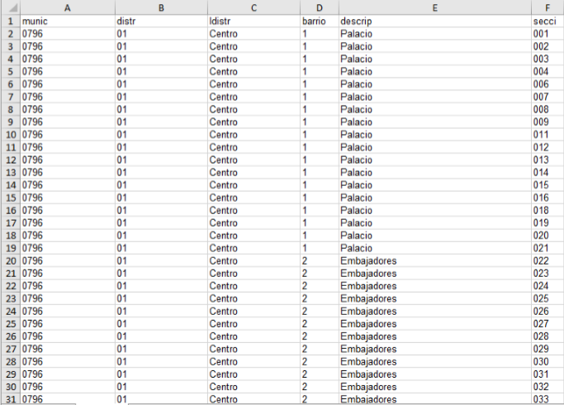
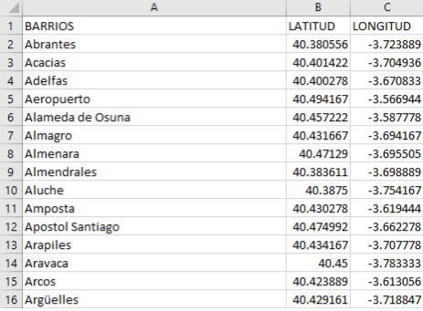
Data overview
Government of the City of Madrid
(All neighborhoods by districts).
Town Hall
(Coordinates).
Local government statistics website
(evolution of the population).

Slide 5
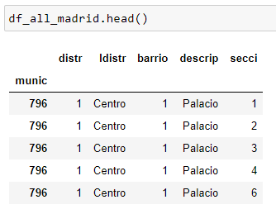
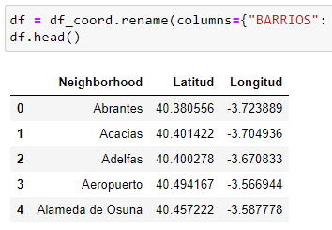
Methodology section (data processing)
The first thing is to process the datasets to get a clean list of neighborhoods with coordinates.

Slide 6
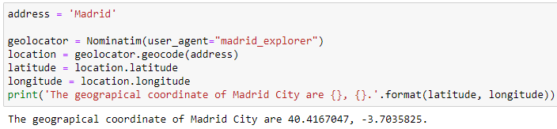
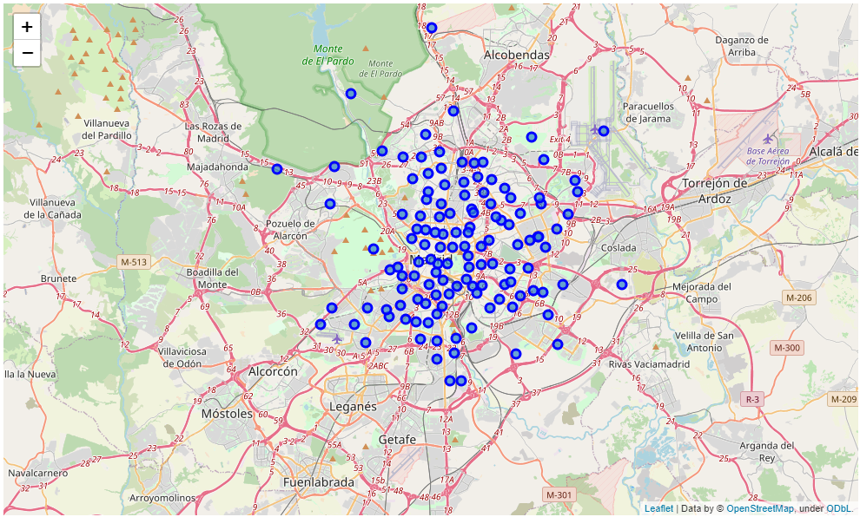
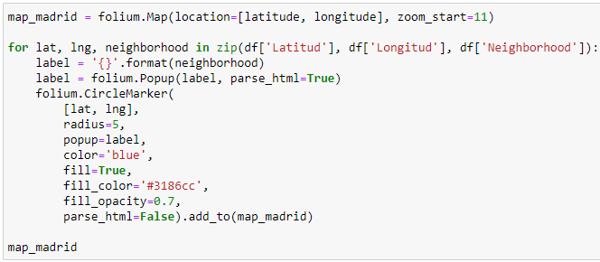
Methodology section (Geolocator and Folium)
We use geolocator to find coordinates of the city.
At this point we are ready for visualize the neighborhoods distribution using folium:

Slide 7
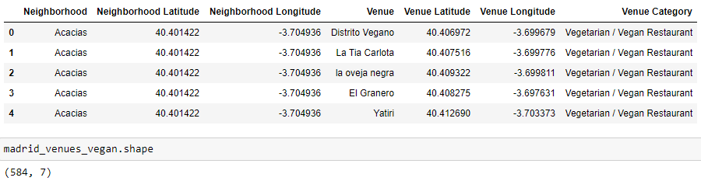
Methodology section (Foursquare API)
To get the total number of places that offer vegan food by neighborhood we use Foursquare.
categoryIds='4bf58dd8d48988d1d3941735'
584 records of vegan restaurants.

Slide 8
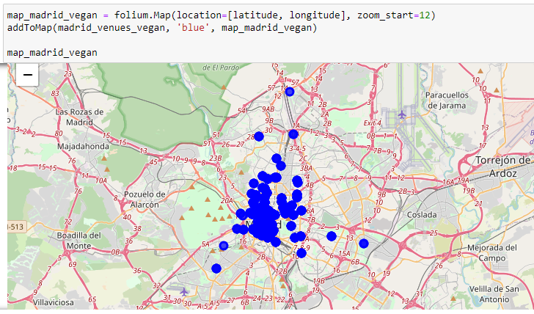
Methodology section (Folium for Restaurants distribution)

Slide 9
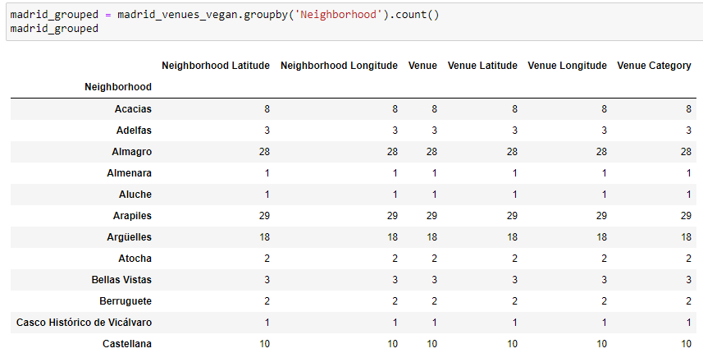
Methodology section (Processing results)
How many per neighborhood:

Slide 10
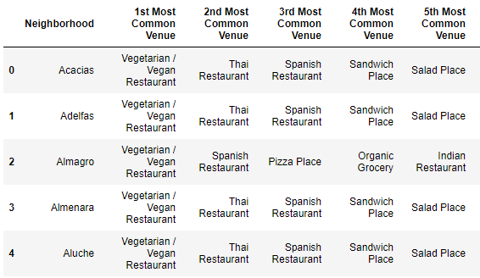
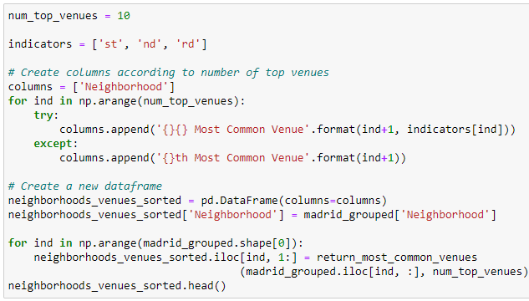
Methodology section (Processing the results)
The most common categories by neighborhood that include vegan food:

Slide 11
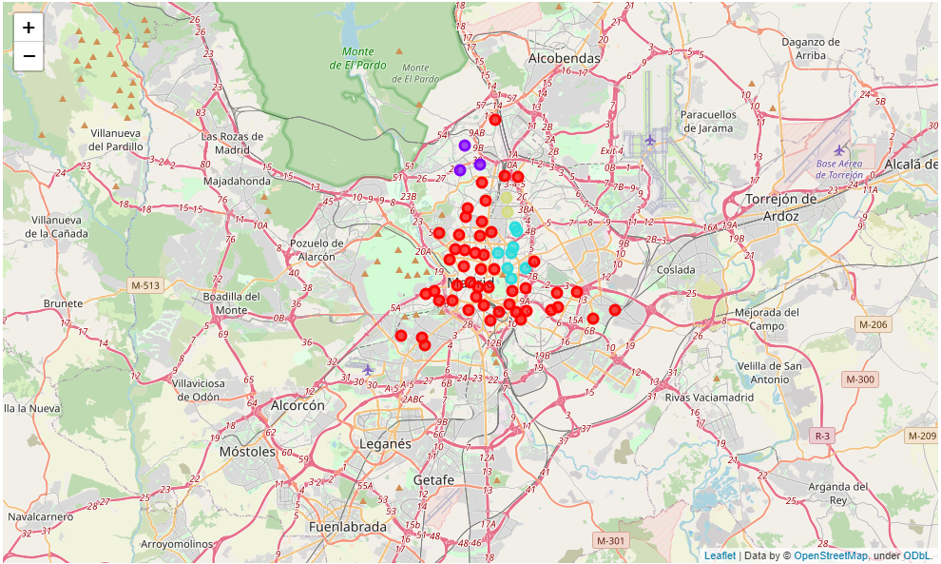
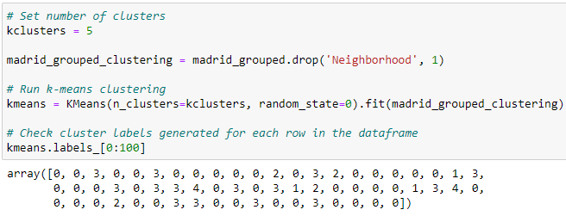
Methodology section (k-means clustering)
Split the group of restaurants by clusters:

Slide 12
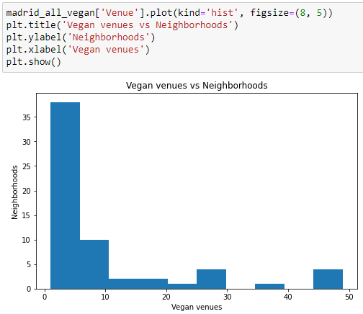
Methodology section (Vegan venues – Neighborhoods / matplotlib.pyplot)
Most neighborhoods contain fewer
than 10 vegan restaurants.
THIS IS GOOD.

Slide 13
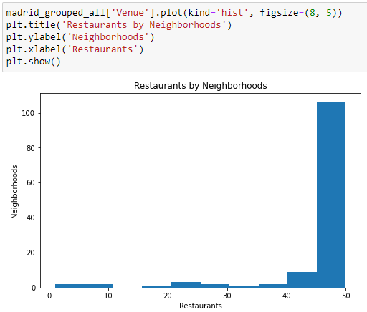
Methodology section (Foursquare API / matplotlib.pyplot)
Distribution of restaurants of any kind in the
city (all neighborhoods).
- Partial conclusion :
Restaurants are very common places in Madrid,
practically all the neighborhoods have between
45 and 50 places of this type.

Slide 14

Methodology section (New variable)
According to the popularity of restaurants by
neighborhood we can discard very few
of them.
The vegan movement is very popular among
young people, so let's review which neighborhoods
have the largest university movement.

Slide 15
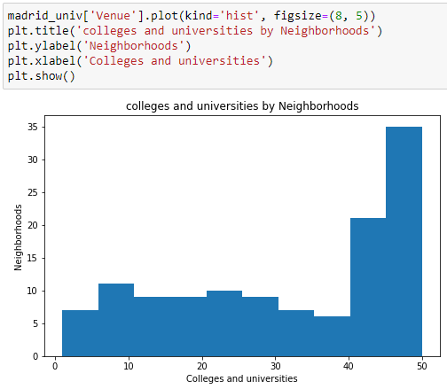
Methodology section (Foursquare API / matplotlib.pyplot)
We focus on neighborhoods with more
than 45 campuses that have some
relationship with universities.
Our list is reduced to:
35 candidates.
DISCARD

Slide 16
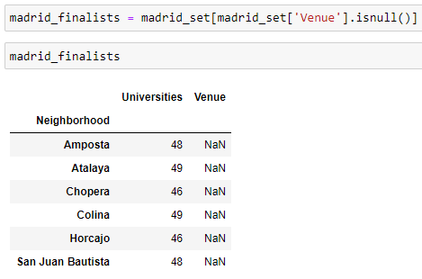
Methodology section (Processing results / join)
Joining the data of Vegan Restaurants by neighborhoods, and the neighborhoods with more university movement we can get the neighborhoods that do not have any restaurant of this type yet and that have a great youthful flow.
Here are the finalists for the poster,
“First Vegan in the neighborhood”. Areas with
high student movement and no vegan options.
6 candidates.

Slide 17
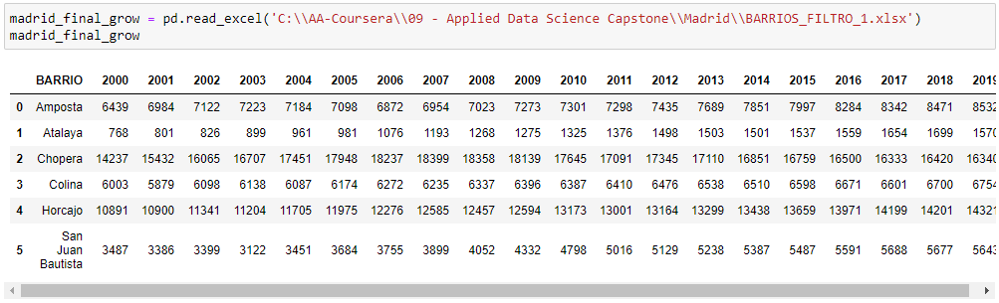
Methodology section (Almost done)
We are going to try to decide for one, in the Web of the Community of Madrid statistical files can be configured to download, we are going to look for the evolution of population of these districts and we will stay with the greater projection of growth.

Slide 18
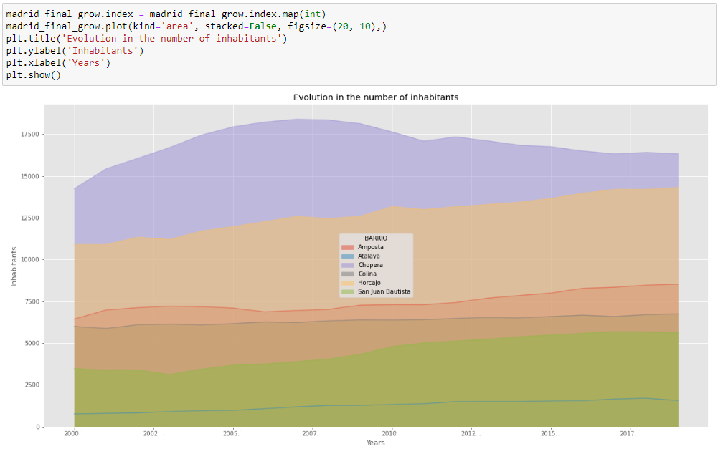
Methodology section (Evolution of population / area plot )
The Horcajo district is the
second one with the largest
fixed population, but it has a
more reliable growth trend.

Slide 19
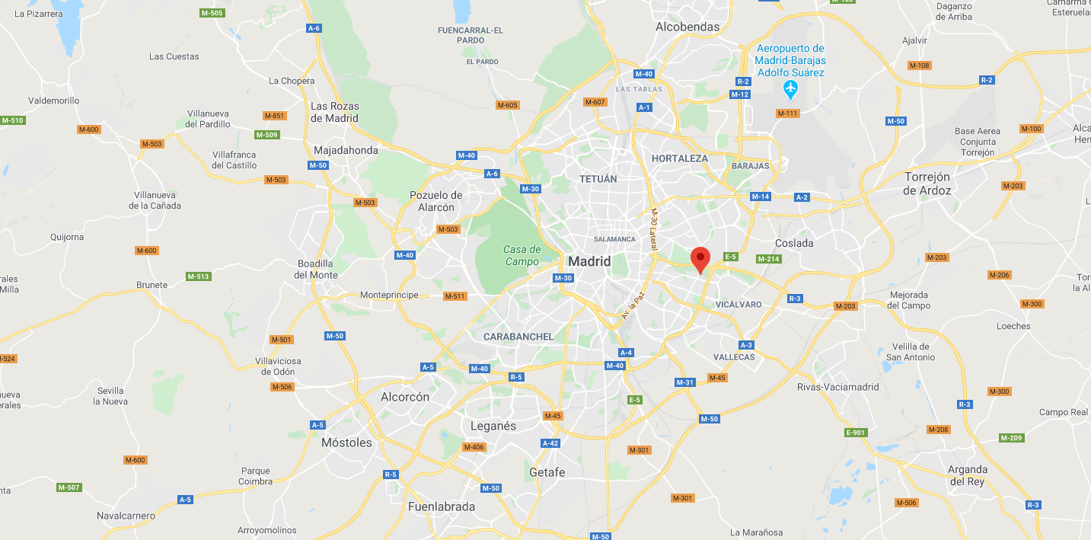
Final decision
With the flow of students in the area and the projected growth of the fixed population, the market share could be assured.
Furthermore, there is no similar restaurant in the entire neighborhood.
The Horcajo neighborhood, is the area
Selected to open a new restaurant.

Slide 20
Conclusions:
We have obtained a good approach to the problem and have found a solution that seems to be satisfactory, however, other factors could be studied further, such as the average income of the area, other recreational areas nearby, and the average price per square meter.
As a conclusion we can say that the objectives of the study have been met.
The aim was to obtain a recommendation for the location of a vegan restaurant and it has been limited to a considerably small area.

